Slide 1




Asphaltene Deposition in Microfluidic System
Yu-Jiun Lin (Nate), Mohammad Tavakkoli, Francisco M. Vargas, Sibani Lisa Biswal
2014.04.21

Slide 2
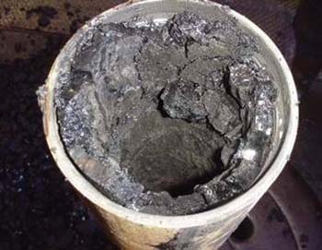
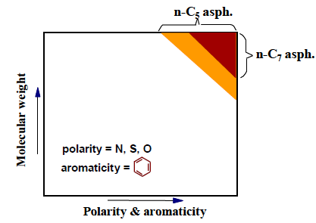
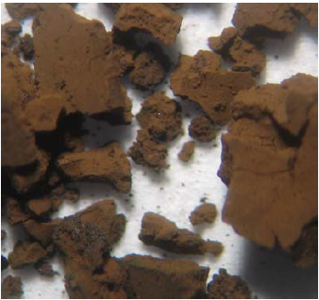
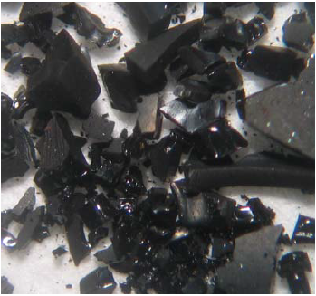
What is Asphaltene?
Polydisperse distribution
Precipitate due to Pressure, Temperature, and composition
n-C₅ Asphaltene
n-C₇ Asphaltene
(Oil industry)
*Jill Buckley’s Lab (New Mexico Tech)
Notes:
Asphaltene is polydisperse in crude oil
Typical looking of C5 and C7 asphaltene
C5 means the precipitant is n-pentane, and C7 is n-heptane

Slide 3
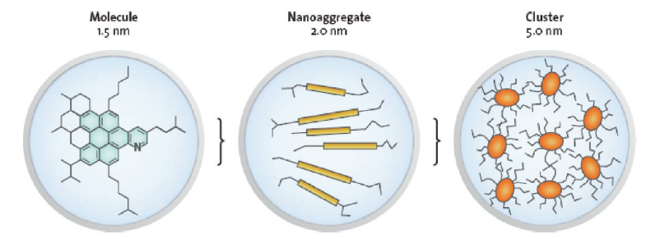
Asphaltene Stages
Yen-Mullins Model
Irreversible deposition
(Aging effect)
Soluble: aromatics (toluene and xylene)
Insoluble: n-alkane (n-heptane and n-pentane)
*O. C. Mullins et al, Energy&Fuels, 2012
Notes:
What is asphaltene? Asphaltene is brownish, black, sticky, and the heaviest part of the crude oil.
In general, asphaltene is defined as a fraction of crude oil insoluble in excess normal alkanes, such as n-pentane or n-heptane but soluble in benzene or toluene
As you can see, this picture is the Yen-Mullins Model, it describes hierarchy of the asphaltene

Slide 4
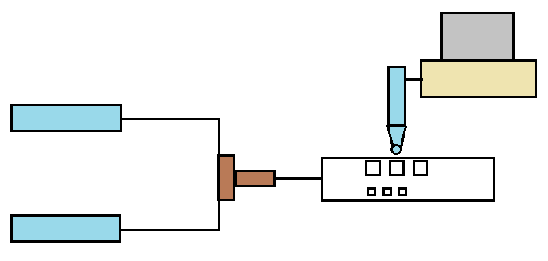
Experimental Setup
Pressure Transducer
Computer
Syringe Pump
Precipitant
Microscope
T-junction
Micro-channel
Crude oil
Vial
Vial
Sample Collection
for viscosity measurement

Slide 5
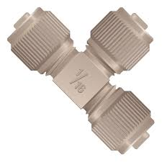
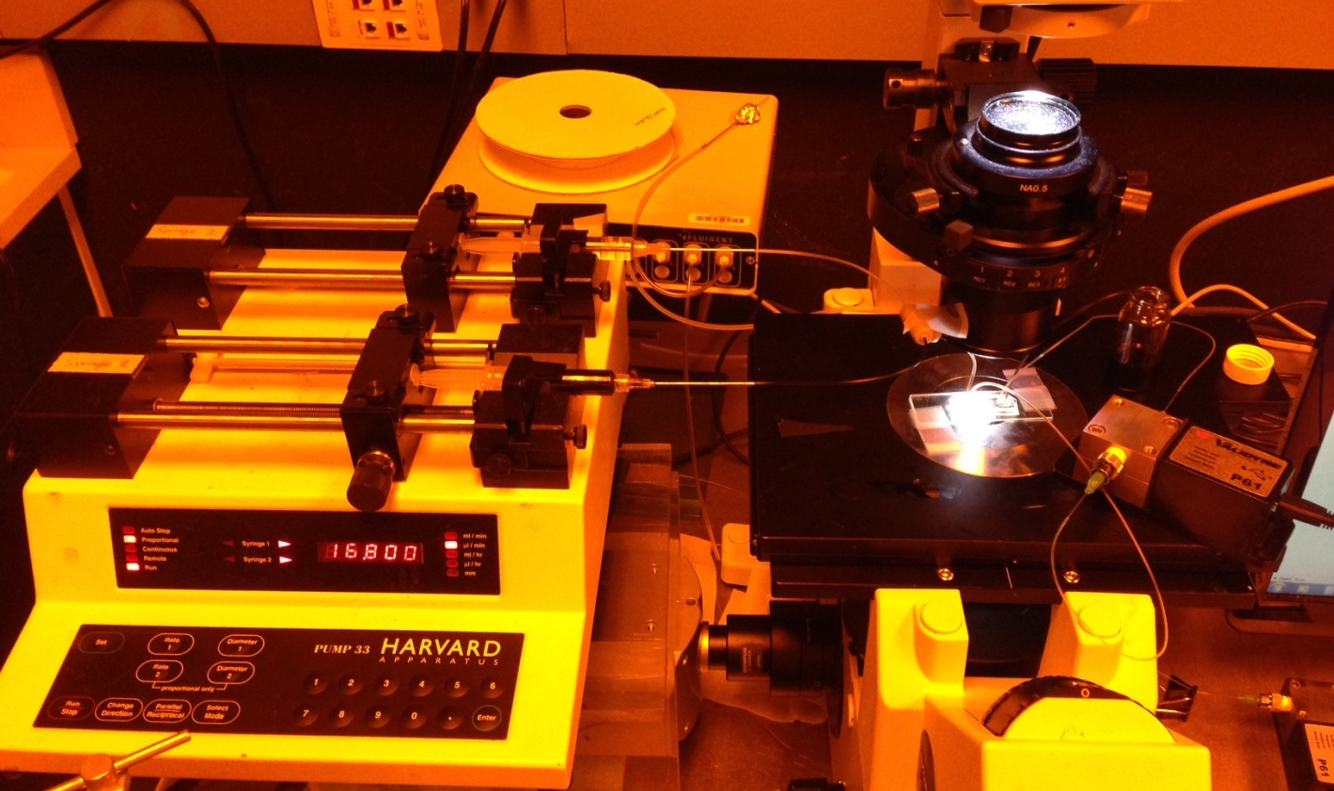
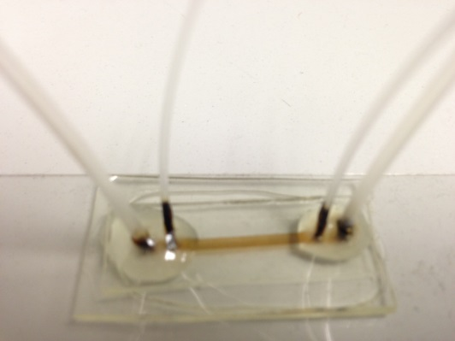
Experimental Setup
T-junction
Inverted Microscope
Vial
Precipitant
Pressure
Transducer
Crude oil
Micro-channel
Syringe Pump

Slide 6
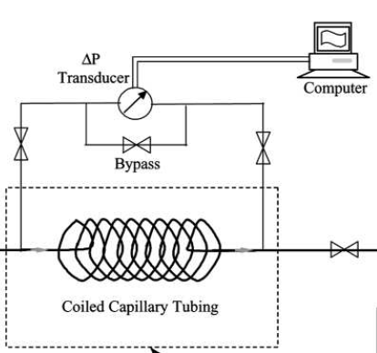
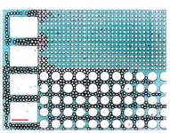
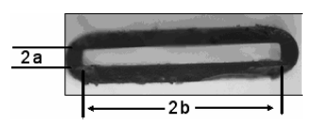
Previous Work
Use transparent, organic resistant, and porous media design
50μm
500μm
Glass capillary tube-> not easy to design a complex pattern and size is too big
PDMS->not organic resistant
Stainless steel -> not transparent
*E. S. Boek et al, Energy&Fuels, 2008
*J. Wang et al, J. Disp. Sci. &Tech., 2004
*K. Ma et al, Soft Matter, 2012

Slide 7


Real-time Asphaltene Deposition
n-C7 78.4%, Oil 21.6%
20 Celcius
Centrifuged oil
60 μl/min
H : 20 μm
Asphaltene : 0.21 wt%
125μm
22μm
Notes:
Reduce the porosity and permeability

Slide 8
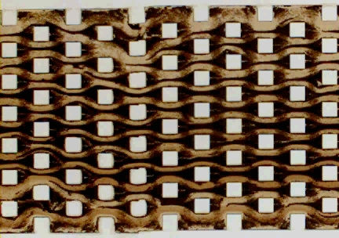
Permeability Reduction
Imaging Process
Homogeneous micromodel
Pressure transducer
Calculation

Slide 9
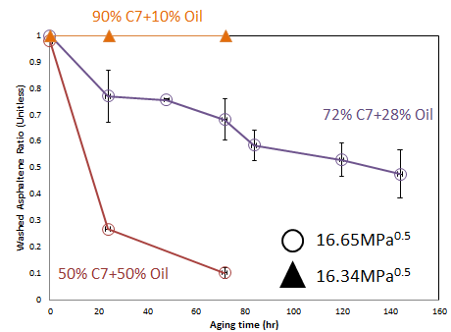
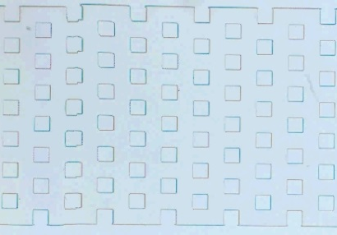
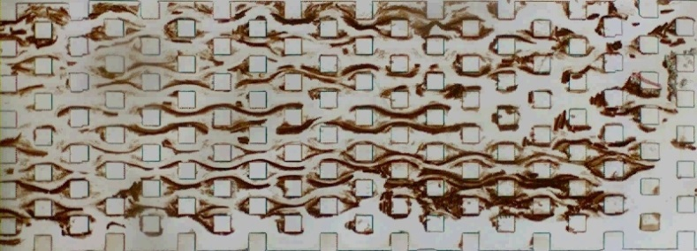
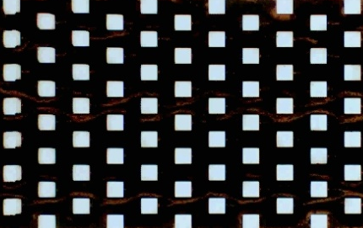

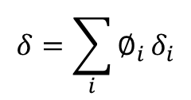
Aging Effect
Aging time : 0 hr
Aging time : 144 hr
Original picture (Before washing)
$$δ=\sum_{i}{∅_{i}}δ_{i}$$
∅i : volume fraction
Solubility parameter for mixture:
$δ$i : solubility parameter for pure substance
$$Washed Asphaltene Ratio=\frac{Washed asphaltene}{Total original deposited asphaltene}$$

Slide 10
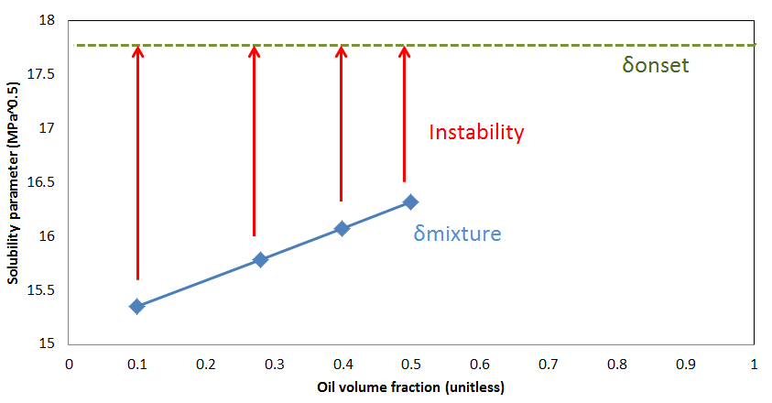
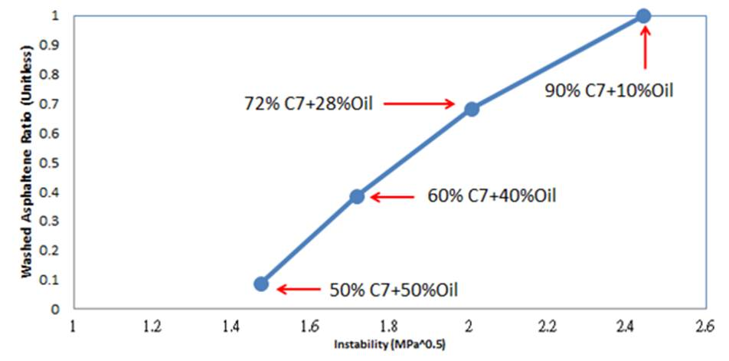
Instability for Aging
Instability: (δonset – δmixture)
(δonset – δmixture90)
(δonset – δmixture72)
(δonset – δmixture50)
Aging time : 72 hrs
The higher the instability,
the more soluble asphaltene
will precipitate out.

Slide 11
Instability for Deposition
Ratio of nC7
Instability: (δonset – δmixture)

Slide 12
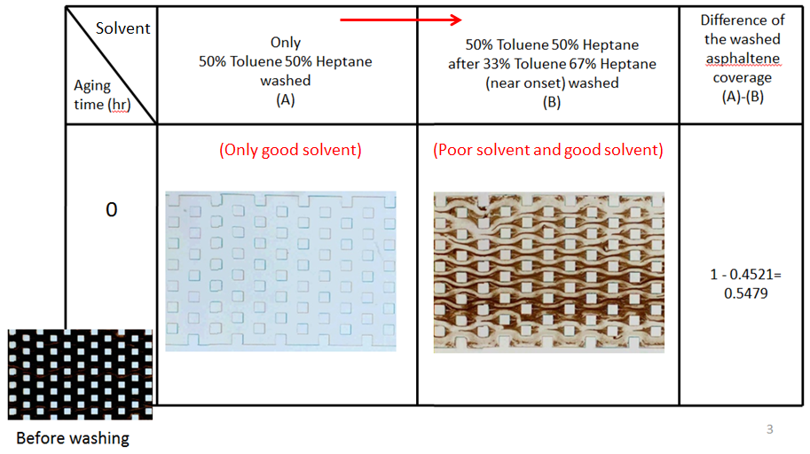
Washing Effect
Before washing

Slide 13
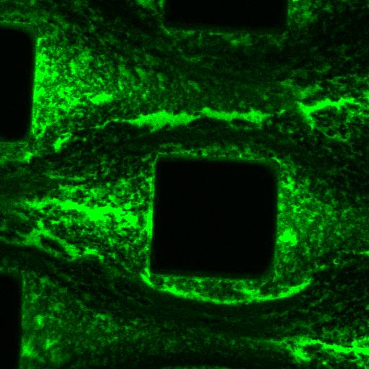
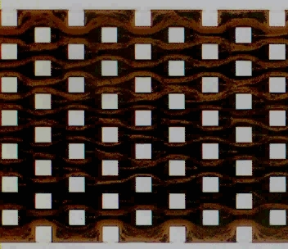
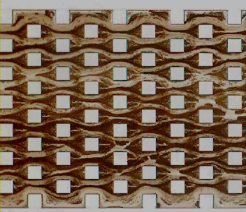

Confocal Laser Scanning
Before washing
Dissolved asphaltenes
and resins
Washing enhanced the aging effect
Washed by poor solvent
After 67%heptane and 33% toluene washed (Poor solvent)
Increased light intensity from the original imaging by 70%

Slide 14
Conclusion
Organic resistant microfluidic channels are able to provide real time asphaltene deposition with permeability reduction.
With high sensitivity micromodels, aging and washing effects can be analyzed.
A criteria for the instability of aging effect and deposition is proposed.

Slide 15
Acknowledgement
This work was financially supported by
ADNOC

Slide 16
Thank you

Slide 17


Aggregate Fluorescence
Model oil: C₇₊ Asph.+Toluene
Model oil + Heptane
The fluorescence is coming from both resins and dissolved asphaltenes.
By adding heptane to the mixture, asphaltenes start to aggregate and these
asphaltene aggregtaes are not fluorescent.

Slide 18


C7+ dilute 40x
Excitation wavelength for confocal laser scanning

Slide 19
C7+ dilute 40x
Excitation wavelength for confocal laser scanning

Slide 20
C7+ dilute 40x

